Slide 1
High Speed Turbojet Instrumentation
Chantel Flores
William Rektorik
Orlando Rodriguez
Faculty Advisors
Dr. Isaac Choutapalli
Faculty Co-Advisor
Dr. Robert Jones

Slide 2
Concept Selection
Functional Decomposition
Engine Mount
Instrumentation
Structure
Methodology
Literature Search
Competitive Products
Brain Storming

Slide 3
Concept Selection for Engine Mount
Concept Variants
Rail
Linkage
Force Plate
Design Constraints
Cost
Accuracy
Reliability
Damping

Slide 4
Design Constraints
Sub-Function 1 -Engine Mount/Thrust Measurement
 | Cost | Accuracy | Reliability | Damping | Row Sum | Norm Score
Cost | x | 1 | 2 | 3 | 6 | 0.167
Accuracy | 5 | x | 3 | 4 | 12 | 0.333
Reliability | 4 | 3 | x | 4 | 11 | 0.306
Damping | 3 | 2 | 2 | x | 7 | 0.194
Col. Score | 12 | 6 | 7 | 11 | 36 | 1
12/36 =

Slide 5
Concept Variants
Cost
 | Rail | Linkage | Force plate | Row Sum | Norm Score
Rail | x | 3 | 5 | 8 | 0.444
Linkage | 3 | x | 5 | 8 | 0.444
Force plate | 1 | 1 | x | 2 | 0.111
Col. Score | 4 | 4 | 10 | 18 | 1
Accuracy
 | Rail | Linkage | Force plate | Row Sum | Norm Score
Rail | x | 4 | 3 | 7 | 0.389
Linkage | 2 | x | 2 | 4 | 0.222
Force plate | 3 | 4 | x | 7 | 0.389
Col. Score | 5 | 8 | 5 | 18 | 1
Reliability
 | Rail | Linkage | Force plate | Row Sum | Norm Score
Rail | x | 4 | 2 | 6 | 0.333
Linkage | 2 | x | 2 | 4 | 0.222
Force plate | 4 | 4 | x | 8 | 0.444
Col. Score | 6 | 8 | 4 | 18 | 1
Damping
 | Rail | Linkage | Force plate | Row Sum | Norm Score
Rail | x | 4 | 4 | 8 | 0.444
Linkage | 2 | x | 3 | 5 | 0.278
Force plate | 2 | 3 | x | 5 | 0.278
Col. Score | 4 | 7 | 7 | 18 | 1

Slide 6
Concept Comparison
Rail System
Linkage System
Force Plate System
24in
10in
13in
48in
18in
24in
Advantage | Disadvantage
Vibration Isolation | Alignment Issues
Low Cost
Compact
Advantage | Disadvantage
Simple to Manufacture | Alignment Issues Vibration
Low Cost
Advantage | Disadvantage
Static Mounting | Safety Hazard High Cost
Reliable

Slide 7
Chosen Thrust Measurement – Rail System
10in
4.5in
13in
18in
24in
24in

Slide 8
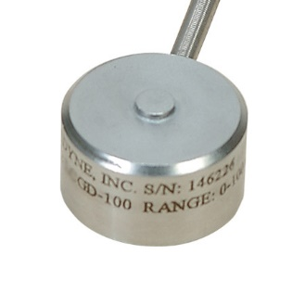
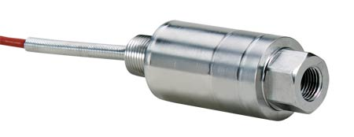
Functional Decomposition
Engine Mount
Instrumentation
Structure

Slide 9
Pitot Traversing Mechanism
Final Design
Engine and Engine Mount
60 in
60 in
24 in

Slide 10
Engine Mount
10in
13in
18in
24in

Slide 11
Force Transfer Rods
Mounting Plate
Engine Mount
Load Cell
Rail System
Isolated Plate
Sorbothane

Slide 12
Pitot Traversing Mechanism
24in
26in

Slide 13
Engineering Analysis
Vibration
Deflection
Total System Precision
Static

Slide 14
Deformation of Frame
Load = 40lbs
Element : Beams
Boundary Condition : Fixed Feet
Nodes : 612
Material : Steel
Max Displacement = 0.005 [in]
40lbs
SolidWorks – Static Analysis

Slide 15
Peak Stress of Frame
Load = 40lbs
Element : Beams
Boundary Condition : Fixed Feet
Nodes : 612
Material : Steel
Peak Stress = $2.8 [ksi]$
Load = 40lbs
Element : Beams
Boundary Condition : Fixed Feet
Nodes : 4484
Material : Steel
Peak Stress = $2.8 [ksi]$

Slide 16
Deflection of Pitot Traversing Rod
$$δ_{max}= \frac{{PL}^{3}}{48EI} [in]$$
P
$$δ_{max} :Max displacement [in]$$
$$d=0.5 [in]$$
E $:Modulus of steel [psi]$
$$I :Moment of inertia [{in}^{4}]$$
$E=30 x {10}^{6} [psi]$
$$L :Length [in]$$
$$I= \frac{πd^{4}}{64}{[in}^{4}]$$
$$P :Force [lbs]$$
$$P=5 [lb]$$
$$δ_{max}=0.02 [in]$$

Slide 17
Deflection of Pitot Tube
$$δ_{max}= \frac{{PL}^{3}}{3EI} [in]$$
$$δ_{max} :Max displacement [in]$$
E $:Modulus of stainles steel [psi]$
$$E=27.5 x {10}^{6} [psi]$$
$$I :Moment of inertia [{in}^{4}]$$
$$L=18 in.$$
$$L :Length [in]$$
$$I= \frac{π}{64} \left(d_{o}^{4}−d_{i}^{4}\right){ [in}^{4}]$$
$$d_{i}=0.13 in.$$
$$P :Force [lbs]$$
$$d_{o}=0.31 in.$$
$δ_{max}$ = 0.06 [in]
P = 6.37 lbs

Slide 18
Force Required to Slide Stand
$\sum{F_{y}=0}$
$\sum{F_{x}=0}$
$where W=N=280 \left[lbs\right]$
$μ=0.6$
$F− μN=0$
$F=168 [lbs]$
$168 lbs >40lbs$
N
$$F :Force [lbs]$$
$$N:Normal Force [lbs]$$
F
$$W:Weight [lbs]$$
$$μ: Coefficient of Static Friction$$
$$between Rubber and Concrete$$
W
μN

Slide 19
Fatigue Analysis
$$σ_{Bending}= \frac{32M}{πd^{3}} =3.66 [ksi]$$
$S_{n}^{′}= .5S_{u}$
$S_{u}$: Ultimate Tensile Strength
$C_{L}$: Load Factor
$C_{G}$: Gradient Factor
$C_{S}$ : Surface Factor
$C_{T}$: Temperature Factor $C_{R }:Reliability Factor$
$σ_{Bending}$: Bending Stress
F.S. = Factor of Safety
Endurance Limit :
$$S_{n}= S_{n}^{′}C_{L}C_{G}C_{S}C_{T}C_{R}$$
$$S_{n}=\left(0.5X61ksi\right)\left(1\right)\left(1\right)\left(0.79\right)\left(1\right)\left(0.897\right)=21.3 [ksi]$$
$$F.S. = \frac{S_{n}}{σ_{Bending}}$$
$F.S. = 5.8$
$$d=0.5 [in]$$
F = 10 [lbs]
$$L =4.5 [in]$$
Notes:
1020 cold drawn steel, 90% reliability

Slide 20
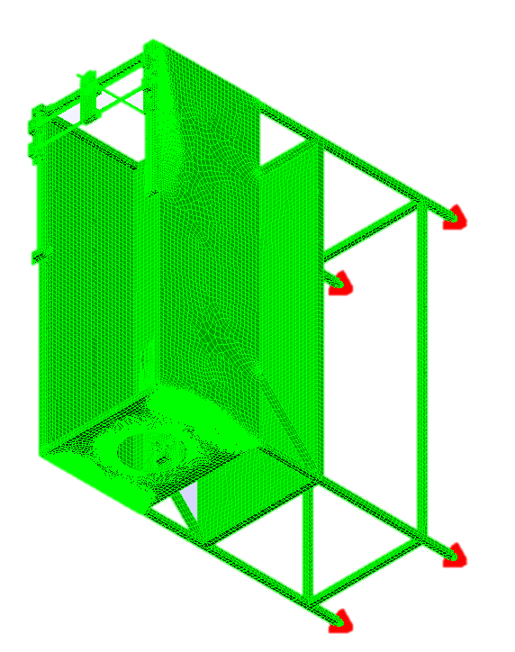
Mode Shape Analysis
Turbojet operating range : 533-2083 [Hz]
Identify structural resonance frequencies
Finite Element Method to be used to find mode shapes
Convergence of solution must be shown

Slide 21
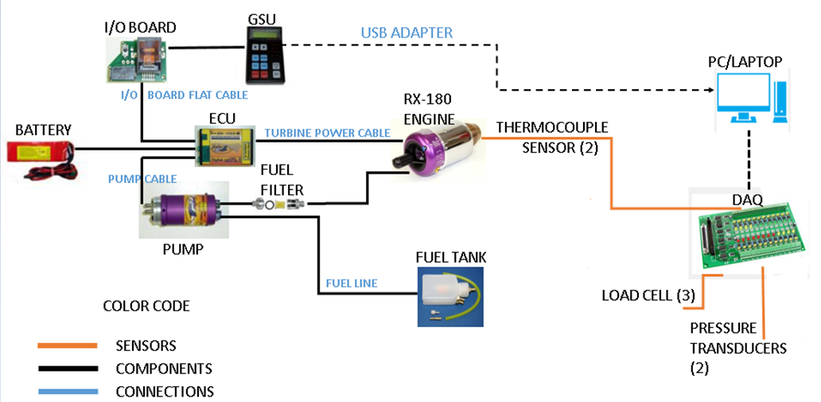
Wire Diagram for All Sensors of Engine

Slide 22
Zero-Order Uncertainty Analysis
Design-stage uncertainty
$u_{d}$=$\sqrt{μ_{0}^{2}+μ_{c}^{2}}$
Interpolation error
$u_{0}$
Instrument errors
$u_{c}$

Slide 23
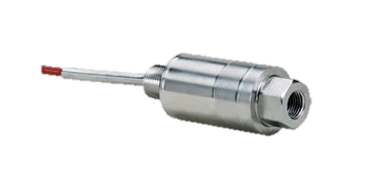
Zero-order Uncertainty Analysis for the Pressure Transducer
1: Pressure Transducer
a: Resolution: $u_{o}$= Interpolation Error= $\frac{u_{o}}{2}$
DAQ Resolution: $u_{o}$
12-bit DAQ
$u_{o}$= $\frac{E_{FSR}}{2^{m}}$=$\frac{10V}{2^{12}}$=0.0024V
→0.0024 Psi/30=0.01%
$u_{o}$=0.01%
b: Elemental Errors
e₁= linearity, hysteresis, repeatability=0.25%
e₂= zero balance=2.0%
Net Elemental Instrument Error = $u_{c}$= $\sqrt{e_{1}^{2}+e_{2}^{2}}$= $\sqrt{{0.25}^{2}+2^{2}}$
c: Zero-Order Uncertainty (Design-stage Uncertainty)
$u_{d}$=$\sqrt{u_{1}^{2}+u_{2}^{2}}$=$\sqrt{{(0.01)}^{2}+{(2.05)}^{2}}$=2.05>2%
OMEGA PX35D0 General Purpose
Pressure Transducer
Specifications
Excitation: 10 Vdc (15 V max)
Output: 3mV/V
Accuracy: 0.25% linearity, hysteresis and repeatability combined
$\frac{3mV}{V}$ x 10V = 30mV
0-30 psi : pressure range
0-30 mV
30 psi – 30 mV

Slide 24
References
By Continuing to Browse the Site You Are Agreeing to Our Use of Cookies. Find out More Here. "PA Hilton Engineering Teaching Equipment. Technical Training Equipment. Vocational Equipment." PA Hilton Engineering Teaching Equipment. Technical Training Equipment. Vocational Equipment. N.p., n.d. Web. 22 Sept. 2016. <http://www.p-a-hilton.co.uk/>.
"Emprise Corporation." ZoomInfo. N.p., n.d. Web. 29 Sept. 2016. <http://www.zoominfo.com/c/Emprise-Corporation/17303129>.
"GDJ Inc." ZoomInfo. N.p., n.d. Web. 22 Sept. 2016. <http://www.zoominfo.com/c/GDJ-Inc/15712337>.
Group, JPS Design. "Welcome." GDJ, Inc. N.p., n.d. Web. 22 Sept. 2016. <http://www.gdjinc.com/>.
"Integrated Flow Systems Llc." ZoomInfo. N.p., n.d. Web. 29 Sept. 2016. <http://www.zoominfo.com/c/Integrated-Flow-Systems-Llc/343510787>.
N.p., n.d. Web. <http://www.p-a-hilton.co.uk/teaching-equipment-for-sale.php?buy=327&addid=327>.
"P A Hilton." ZoomInfo. N.p., n.d. Web. 22 Sept. 2016. <http://www.zoominfo.com/c/P-A-Hilton/348843272>.
P.A. Hilton. N.d. Jet Propulsion Test Stand P372 Specs. England, Hampsire Stockridge.
Turbine Technologies. 2014. Turbo gen. Chetek, Wisconsin.
Turbine Technologies- Creating Educational Lab Equipment For Tomorrow's Engineers. "Controls Lab ." Turbine Technologies. N.p., n.d. Web. 22 Sept. 2016. <http://www.turbinetechnologies.com/>.
Turbine Technologies Inc. 2014. MiniLab Specs. Chetek, Wisconsin.
"Turbine Technologies Inc." ZoomInfo. N.p., n.d. Web. 22 Sept. 2016. <http://www.zoominfo.com/c/Turbine-Technologies-Inc/348276565>

